Slide 1
Milestone 3
Active Directory to Cloud Security Data Pipeline
Team 2: Shahiba Shamshad Michael Butler Mounia Touil Koko Afantchao

Slide 2
Project Recap
Cybriant uses Lucid to visualize identity relationships but Lucid has no native connection to on-premises Active Directory. We built an automated pipeline that pulls identity data from AD, stages it in Google BigQuery, and pushes it into Lucid through an API — so security analysts can see a live visual of their environment.
The Problem: No native integration between on-prem Active Directory and Lucid visualization platform
Our solution: Automated pipeline: AD → PowerShell → BigQuery → Cloud Run → Lucid API
The Goal: Correctness and reliability of data transfer at every stage of the pipeline

Slide 3
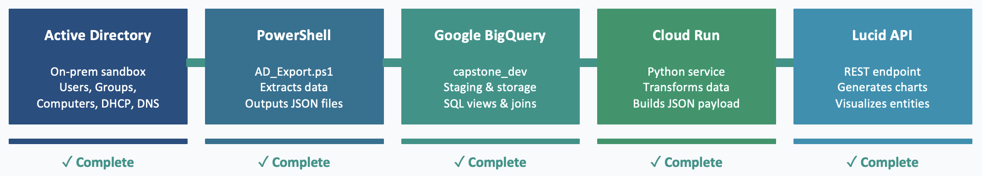
System Architecture
Data Flow:
1- . PowerShell scripts connect to AD and export all objects as JSON files — read-only, no changes made to AD
2- JSON files are uploaded to Google BigQuery into pre-defined tables — computer, user, groupe, dhcp_lease, dns_a_record, inspect_ou
3- Cloud Run service reads latest BigQuery snapshot, normalizes and joins the data, then pushes it to Lucid via REST

Slide 4
Milestone 1(Recap)
Wrote the full Requirements Engineering Document with functional and non-functional requirements
Defined security assumptions — read-only AD access, least privilege IAM, no passwords in command line
Designed the end-to-end architecture diagram — AD → PowerShell → BigQuery → Cloud Run → Lucid
Created the BigQuery schema and data model for all AD objects
Planned the Cloud Run to Lucid API interaction and JSON payload structure
Defined logging and error handling strategy for every pipeline stage
Created the private GitHub repository and shared it with the sponsor

Slide 5
Milestone 2 (Recap)
PowerShell scripts that connect to AD and extract users, groups, computers, DHCP, DNS and subnets
Scripts handle errors and partial failures gracefully — designed for future extensibility
Windows scheduled task runs every day at 6pm — fully automated, no manual trigger needed
Each run tagged with a unique run_id and timestamp for traceability
Data successfully loaded into 11 BigQuery tables in the capstone_dev dataset
Relationship views created — vw_rel_computer_ou, vw_rel_user_ou, vw_rel_dns_computer
GitHub repository updated with latest code, documentation and architecture diagrams

Slide 6
Milestone 3 Overview
Built and deployed a microservice to Google Cloud RunPython
Service reads latest BigQuery snapshot, normalizes data and pushes it to Lucid
Set up CI/CD pipeline — GitHub Actions + Cloud Build — 17 successful deployments
Lucid diagrams generated showing identity, systems and network relationships
End-to-end pipeline running and validated from AD all the way to Lucid
GitHub repository finalized with full documentation and README

Slide 7
Solution Overview (BIG ONE)
What We Built:
PowerShell Extraction: cripts connect to AD and pull all identity data — users, computers, groups, DHCP and DNS BigQuery Storage: Scripts connect to AD and pull all identity data — users, computers, groups, DHCP and DNS Cloud Run Service: Python microservice reads BigQuery, transforms the data and pushes it to Lucid via REST API Lucid Visualization:3 relationship diagrams generated — identity, systems and network views of the AD environment

Slide 8
CI/CD Pipeline

Slide 9
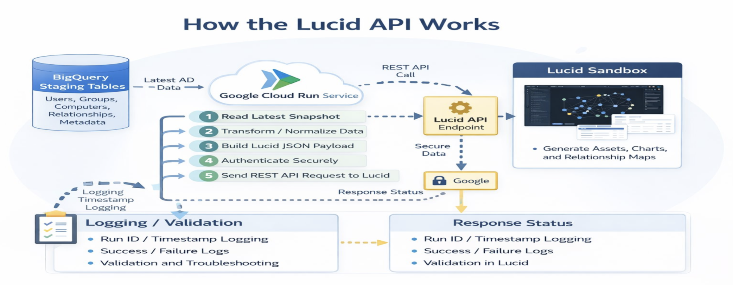
Lucid API Integration

Slide 10
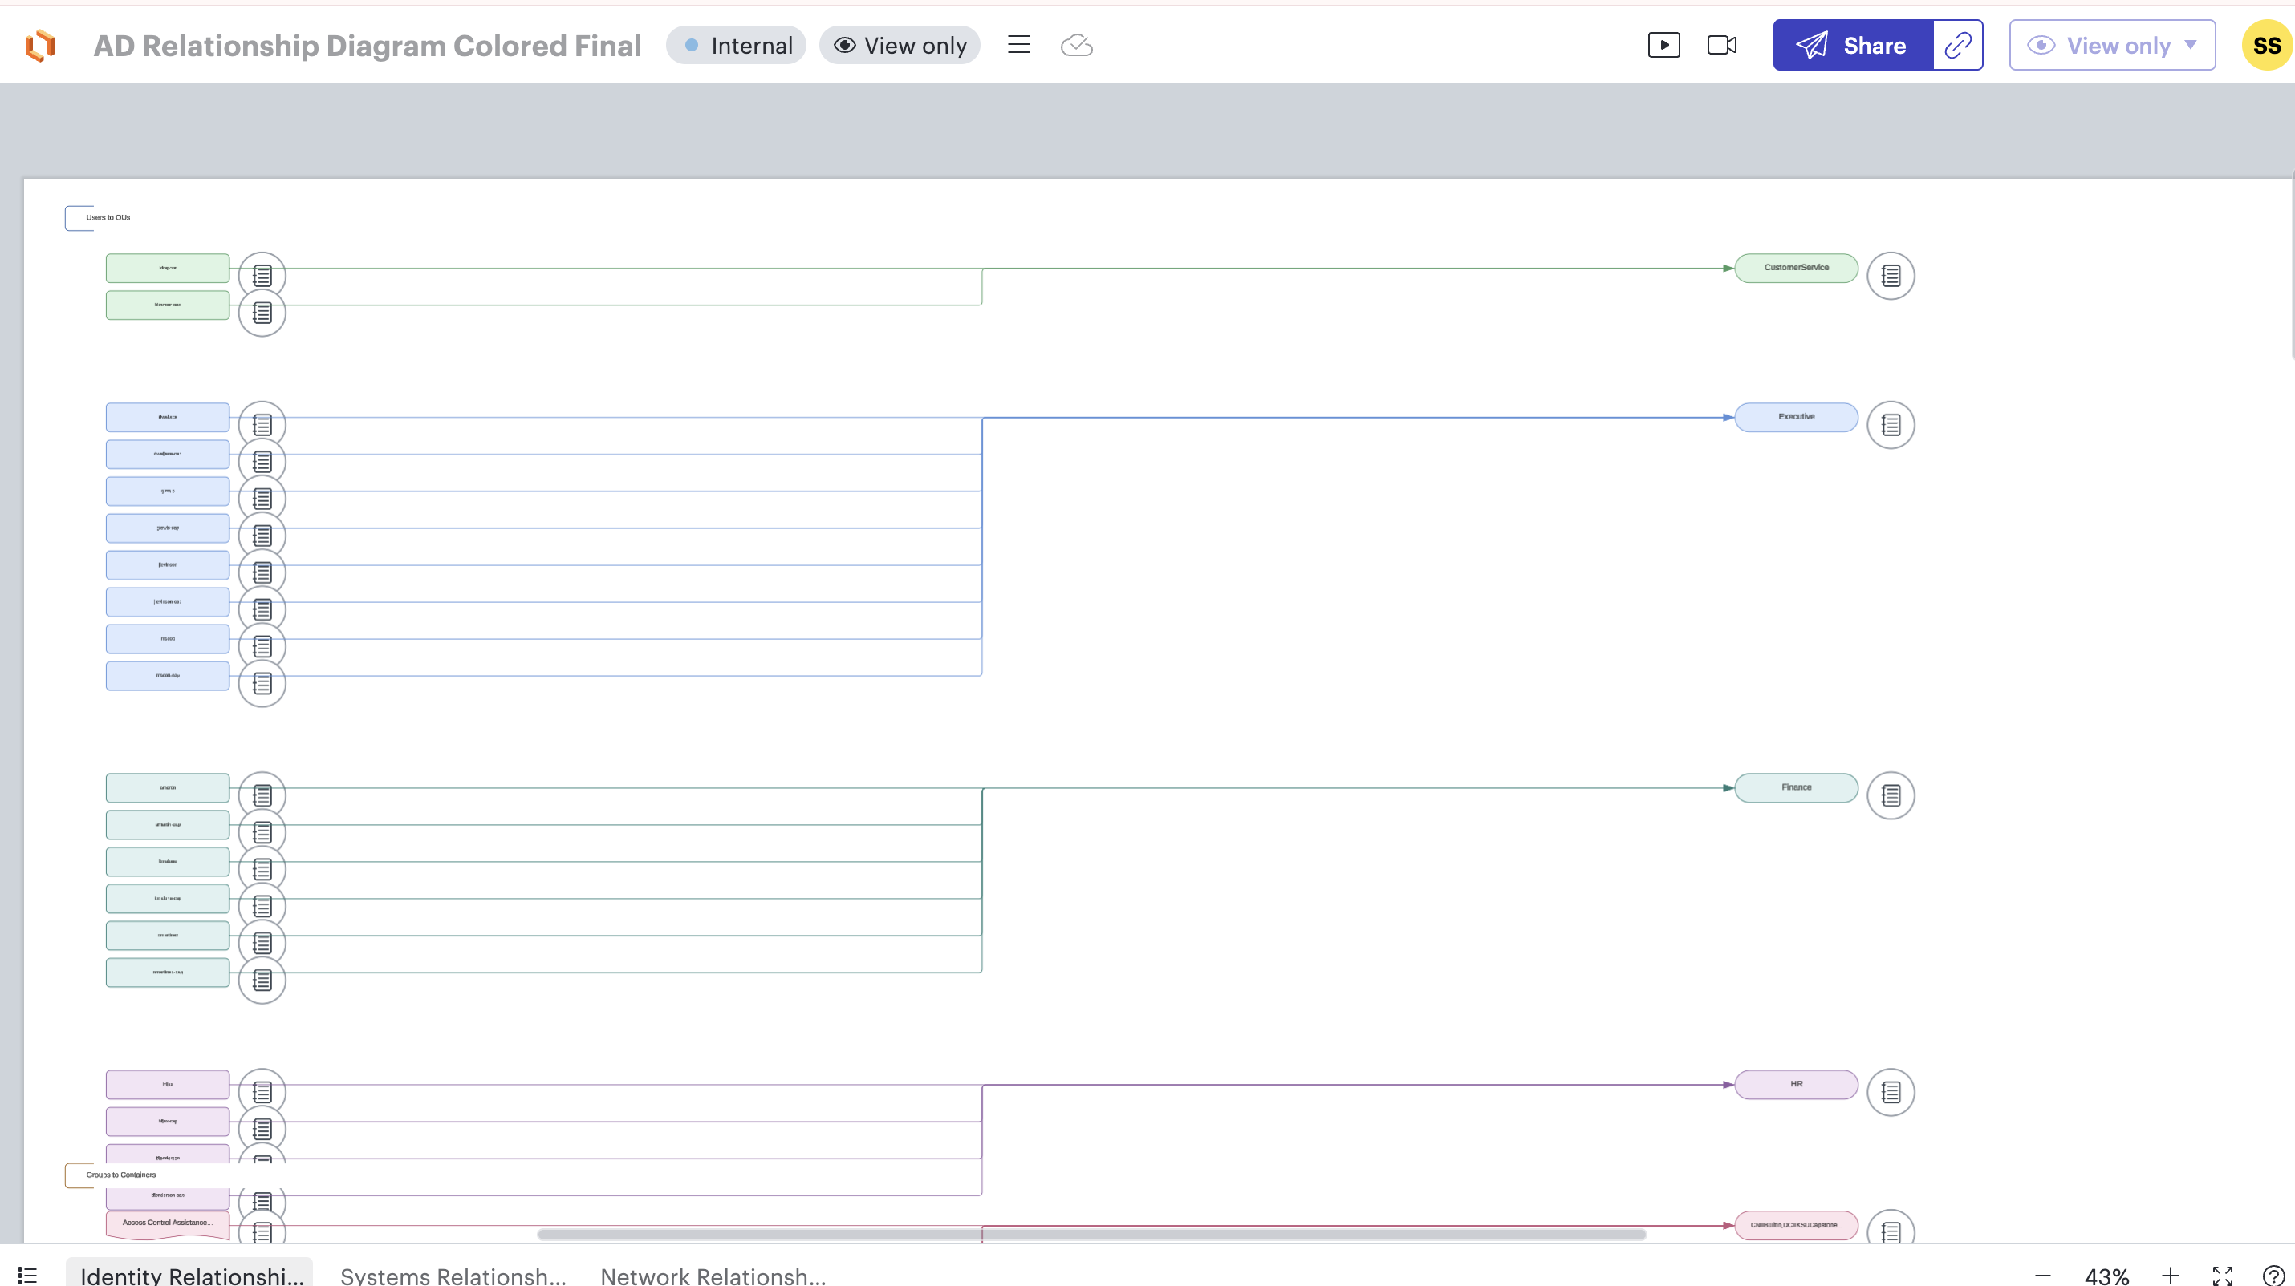
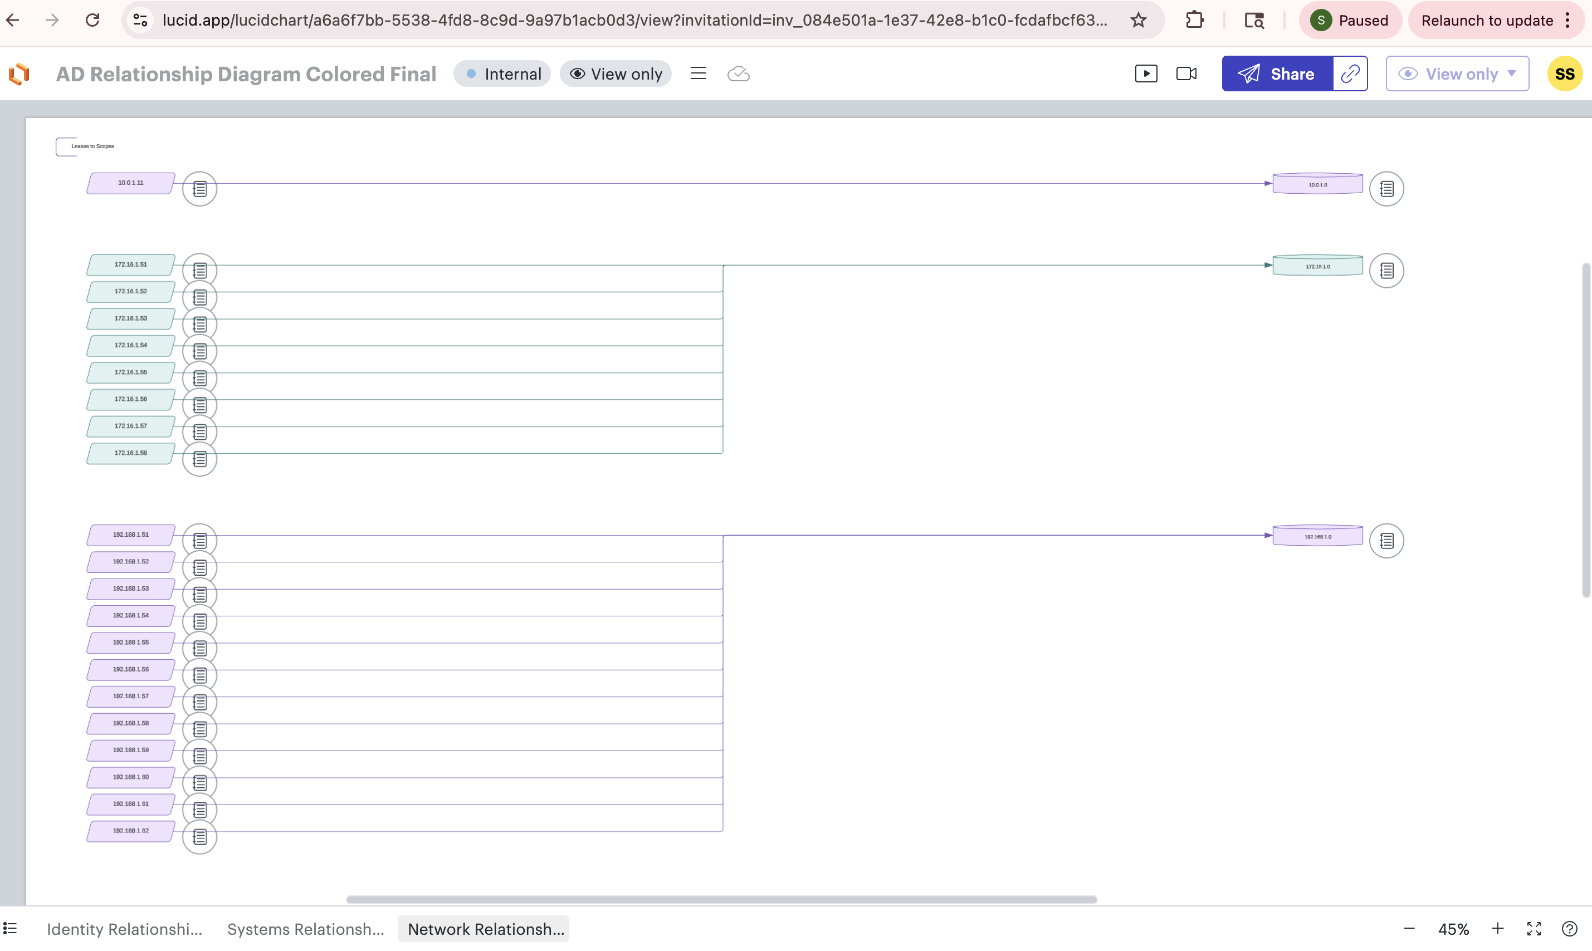
Lucid Visualization

Slide 11
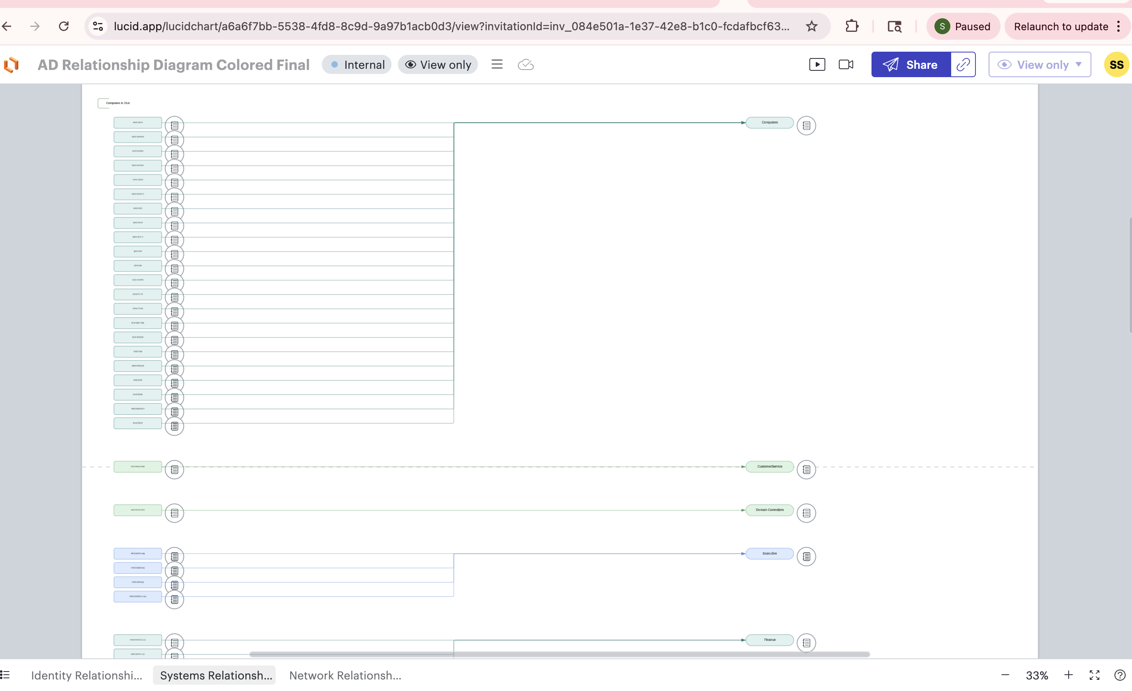
LUCID VISUALIZATION

Slide 12
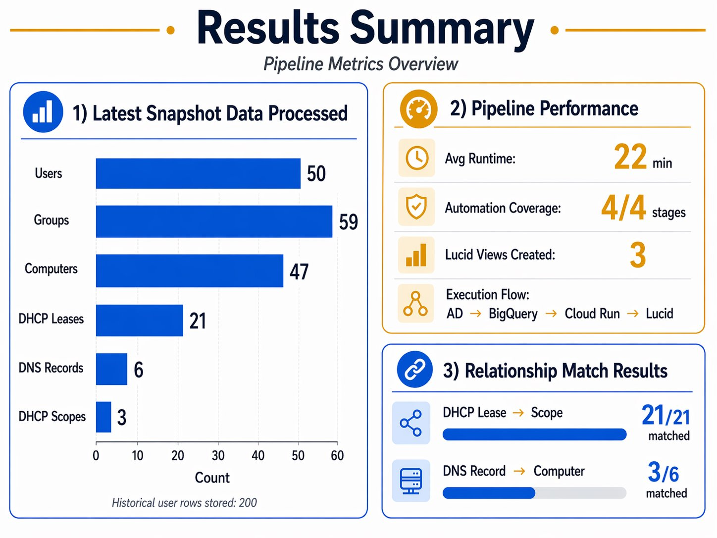
RESULT

Slide 13
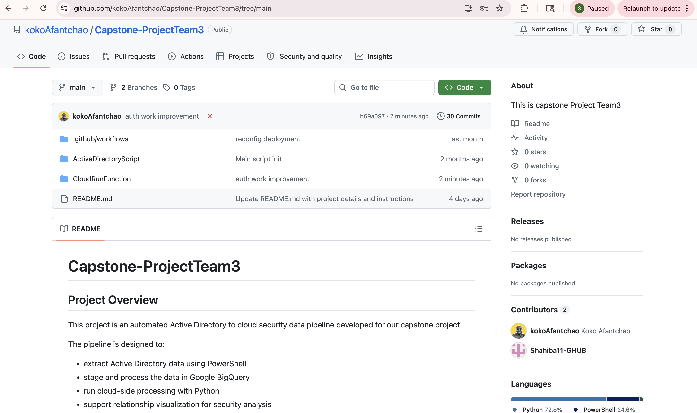
GitHub Repository
https://github.com/kokoAfantchao/Capstone-ProjectTeam3/blob/main/ActiveDirectoryScript

Slide 14
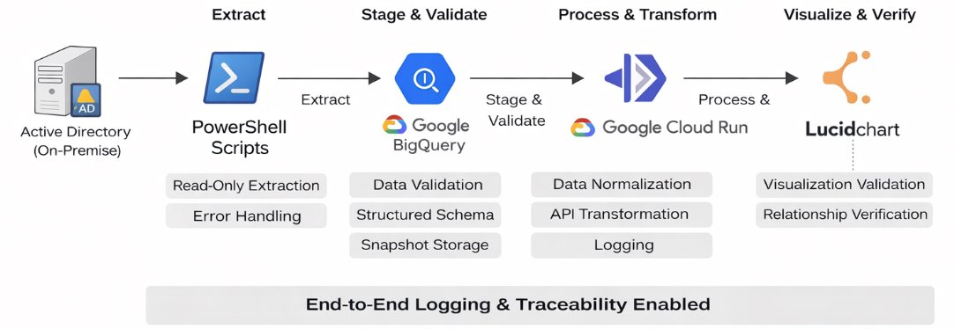
End to End Pipeline

Slide 15
Challenges:
LESSONS LEARNED:
New Tech Stack: None of us had worked with PowerShell, BigQuery, Cloud Run or Lucid API before — learned everything from scratch.

Slide 16
Thank You TEAM 2

